Slide 1

NFHS BASEBALL RULES
CHANGES

Slide 2

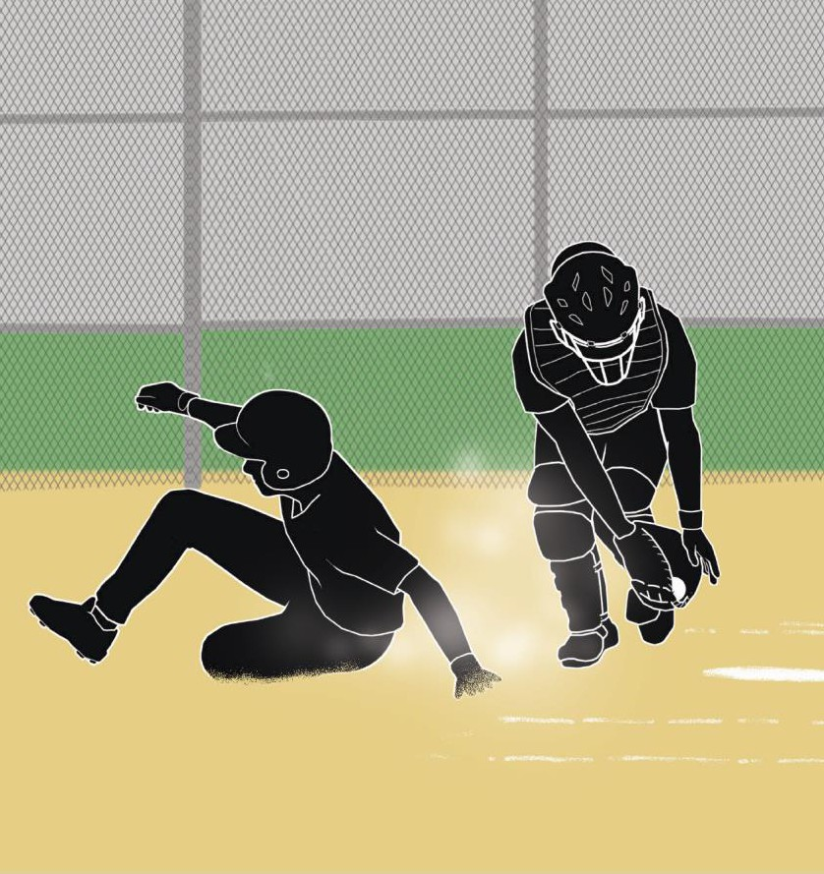

ILLEGAL SLIDE
RULE 2-32-2c
Rule Change
A runner may legally slide past home plate, even if he makes contact with a fielder or alters the play of the fielder, provided the slide meets all other provisions of the sliding rules and he does not initiate malicious contact.

Slide 3
RULE 2-32-2C
Rule Change
ART. 2. . . A slide is illegal if:
Sub-articles a-b remain the same.
c. except at home plate, the runner goes beyond the base and then makes contact with or alters the play of the fielder. At home plate, it is permissible for the slider’s momentum to carry him through the plate in the baseline extended.
Sub-articles d-f remain the same.

Slide 4
RULE 2-32-2C (CONTINUED)
Rule Change
Rationale: The act of sliding is optional. However, if a base runner decides to slide, then he is held to certain criteria to ensure that neither the offensive nor defensive player are intentionally injured. There are six criteria that constitutes an illegal slide. Due to the physical design of home plate, it is not possible for a runner who chooses to slide to stop at or on top of home plate while running as fast as he can to score.

Slide 5
RULE 2-32-2C (CONTINUED)
Rules Reminder
In order to stop at or on home plate, the runner would have to run slower or begin his slide earlier which would give the defense an advantage. This change allows the runner’s momentum to carry him through home plate in a straight line (baseline extended). He is still held to the other elements of Rule 2-32-2 and malicious contact as it relates to interference with the catcher. The catcher is protected because he has choices of locations where he can position himself to avoid contact.

Slide 6
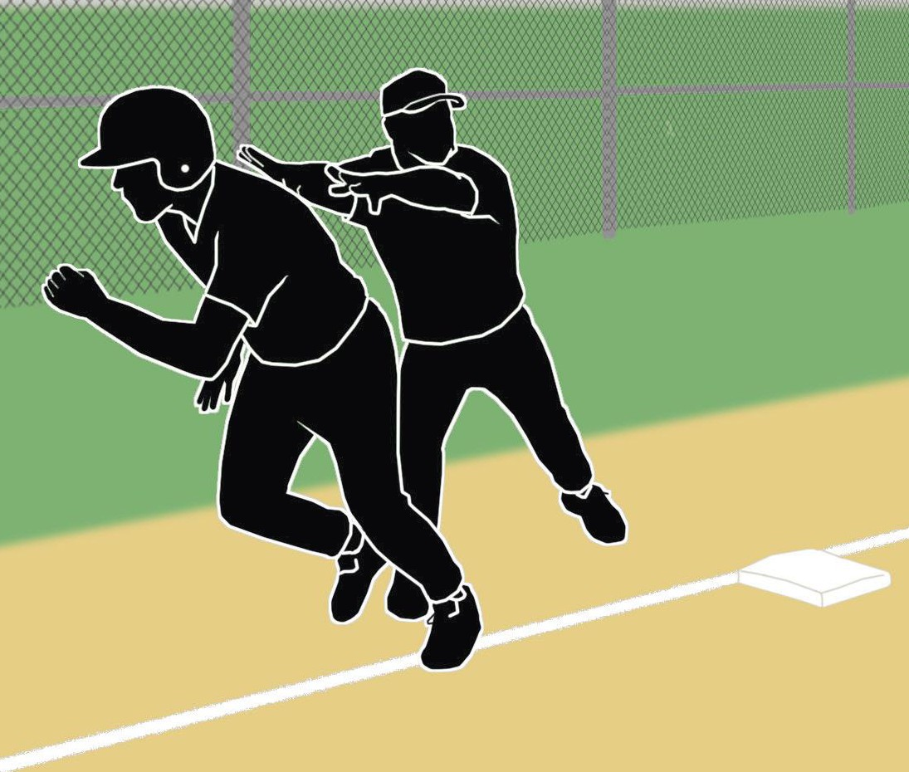
ASSISTING RUNNER
RULES 3-2-2 PENALTY AND 8-4-2s
Rule Change
If a runner is physically assisted by a coach, the runner is called out immediately and the ball remains live.

Slide 7
3-2-2 PENALTY
Rule Change
PENALTY . . . The runner shall be called out
immediately. (8-4-2s)
Rationale: The coach-assisted base runner is called out immediately without deference to other batter- runner(s) and play continues.

Slide 8
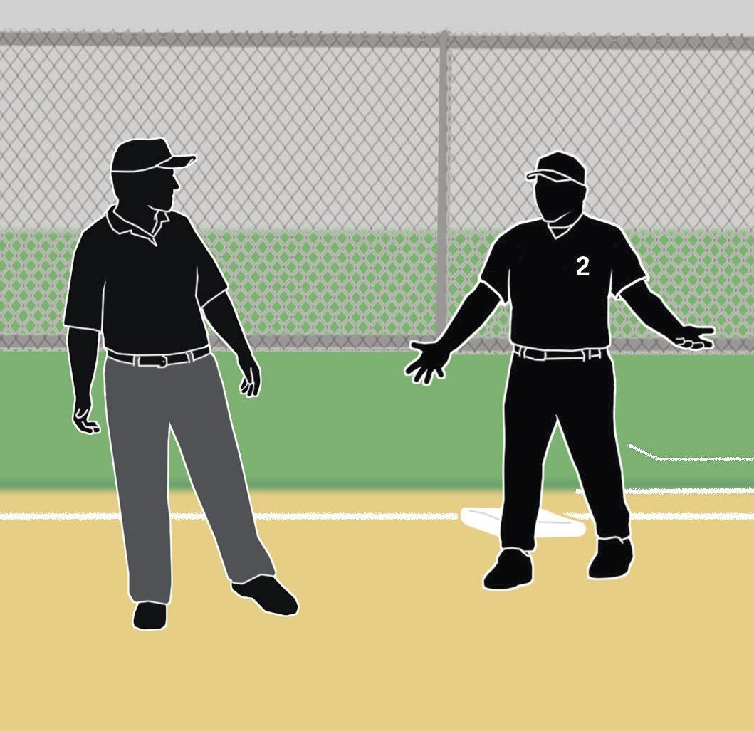
BENCH AND FIELD CONDUCT
RULE 3-3-1 PENALTY
Rule Change
Umpires have access to a three-tier system for dealing with coaches’ misconduct: verbal warning, written warning with restriction to the dugout and, finally, ejection.

Slide 9
BENCH AND FIELD CONDUCT
3-3-1 PENALTY
Rule Change
PENALTY: The umpire shall warn the offender unless the offense is judged to be major, in which case an ejection shall occur. A warning may be verbal or written. If written, the offender shall be restricted to the bench/dugout for the remainder of the game. If a coach has previously received a verbal warning, he shall receive a written warning (10-2-3j) and be restricted to the bench/dugout for the remainder of the game. If a coach has previously received a written warning, he shall be ejected for any subsequent offense.

Slide 10
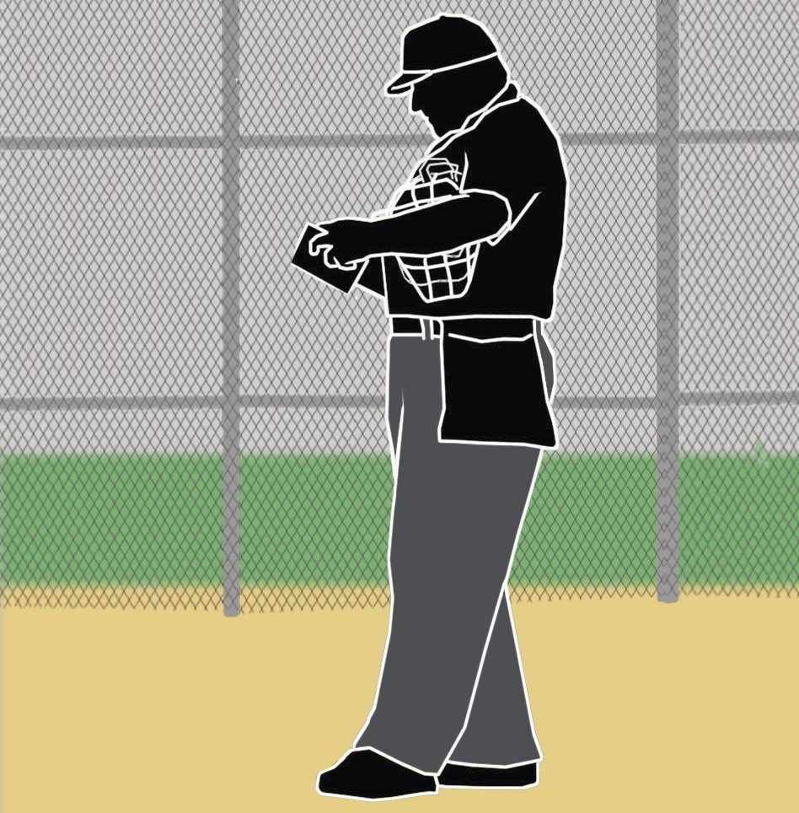
BENCH AND FIELD CONDUCT
RULE 3-3-1 PENALTY
Rule Change
If the umpire judges an offense to be minor, the umpire shall issue a verbal or written warning.

Slide 11
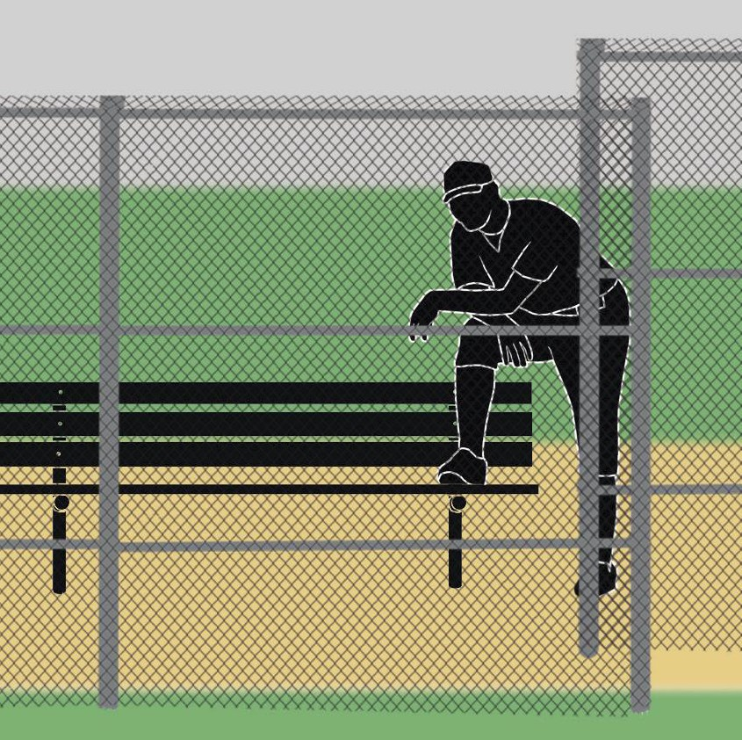
BENCH AND FIELD CONDUCT
RULE 3-3-1 PENALTY
Rule Change
If the warning is written, the coach shall be restricted to the bench/dugout for the remainder of the game. The plate umpire will note the details of the warning on the lineup card.

Slide 12
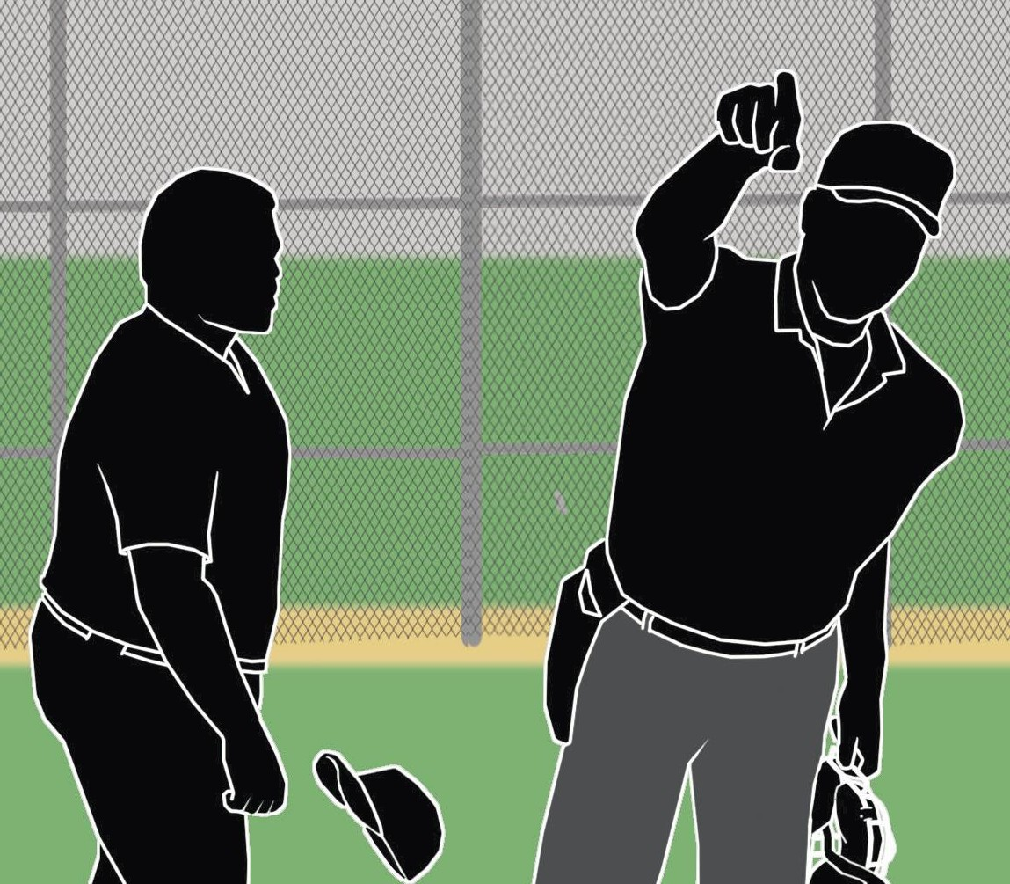
BENCH AND FIELD CONDUCT
RULE 3-3-1 PENALTY
Rule Change
After receiving a written warning, if the coach commits an additional offense, the coach will be ejected from the game.

Slide 13
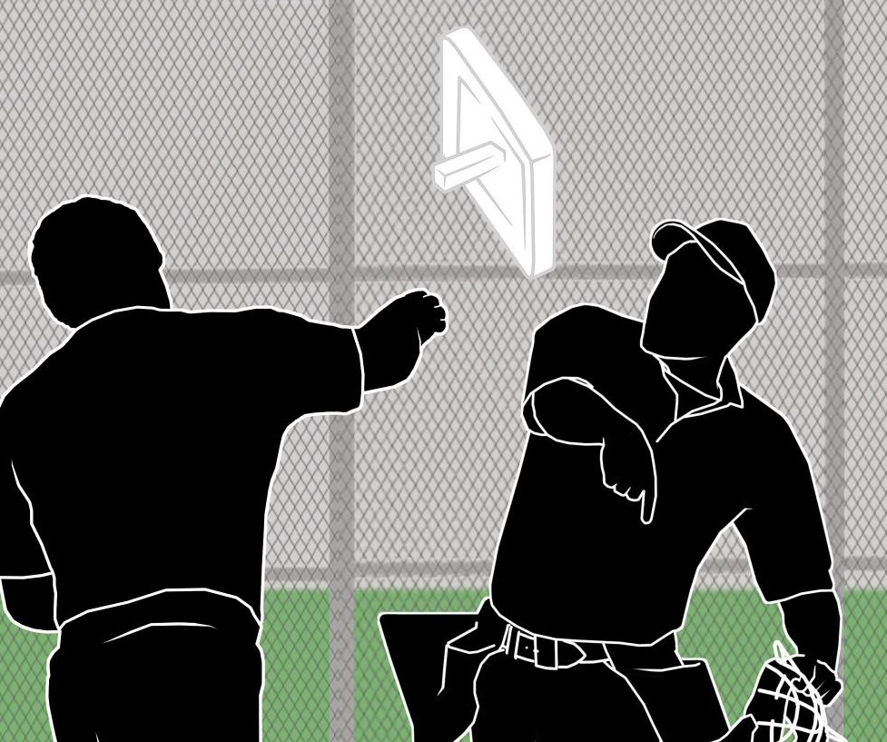
BENCH AND FIELD CONDUCT
RULE 3-3-1 PENALTY
Rule Change
If the umpire deems an offense to be major, such as, “physical contact, spitting, kicking of dirt or any other physical action directed toward an umpire,” the umpire shall immediately eject the coach from the game.

Slide 14
BENCH AND FIELD CONDUCT
3-3-1 PENALTY (CONTINUED)
Rule Change
Any offense judged to be major in nature shall result in an immediate ejection. For coaches who violate f (1-5), g, h, i, j or k, the umpire may: (1) issue a verbal warning to the offender, (2) issue a written warning to the offender (any offender receiving a written warning shall be restricted to the bench/dugout for the remainder of the game), or (3) eject the offender for a major offense.

Slide 15
BENCH AND FIELD CONDUCT
3-3-1 PENALTY (CONTINUED)
Rule Change
For violation of f(6) both the head coach and offending coach shall receive a written warning and be restricted to the dugout for the remainder of the game unless the offense is so severe the umpire may eject the offender and restrict or eject the head coach.
A coach may leave the bench/dugout to attend to a player who becomes ill or injured. In f (7), the state association shall determine appropriate action.

Slide 16
BENCH AND FIELD CONDUCT
3-3-1 PENALTY (CONTINUED)
Rule Change
Rationale: Coaches and officials are equally responsible to provide an ideal learning environment for the students who play baseball. That learning environment is severely disrupted if the adults show a lack of respect for each other’s position and role in the contest. The coach has the responsibility to coach and teach his players about basic and complicated skills of baseball and important life lessons.

Slide 17
BENCH AND FIELD CONDUCT
3-3-1 PENALTY (CONTINUED)
Rule Change
The game official has the obligation to administer the rules of the game and to judiciously address any coach’s or player’s behavior that is not consistent with those rules. As he (umpire) administers any penalty resulting in a warning, restriction to the bench/dugout or ejection, his decision should be in response to the actions by the offending coach and player. The coach needs to understand that his behavior will dictate which level of discipline is applied.

Slide 18
BENCH AND FIELD CONDUCT
3-3-1 PENALTY (CONTINUED)
Rule Change
Utilizing a three-step process, the umpire is given the opportunity to de-escalate any situation that might arise during the course of the game.
This enhancement of last year’s rule provides an additional “teachable moment” element to the current rule. Umpires are given clear procedures for dealing with minor unsportsmanlike behavior while at the same time promoting the practice of keeping coaches and players “in the game” and minimizing ejections.

Slide 19
BENCH AND FIELD CONDUCT
3-3-1 PENALTY (CONTINUED)
Rule Change
We encourage the officials to clearly communicate their warnings and restrictions when possible to the coaches prior to ejection. The coaches also need to recognize when those warnings and restrictions are being issued so they can modify their behavior and continue to teach their players. When the adults are acting in a professional and respectful manner, the young people will be the ultimate winners regardless of the score of the game.

Slide 20

PITCHING RESTRICTION
6-1-6
Rule Change
Each state association shall have a pitching restriction policy based on the number of pitches thrown to afford pitchers a required rest period between pitching appearances.

Slide 21
RULE 6-1-6
Rule Change
ART. 6. . . . Each state association shall have a pitching restriction policy based on the number of pitches thrown to afford pitchers a required rest period between pitching appearances.
Rationale: After years of research and thoughtful discussion on minimizing risk for the position of pitcher, it has been determined that modifying the pitching restriction rule to reflect that the policy should be based on the number of pitches thrown is a better indication of overuse and repetition than the current method of innings pitched during a contest.

Slide 22
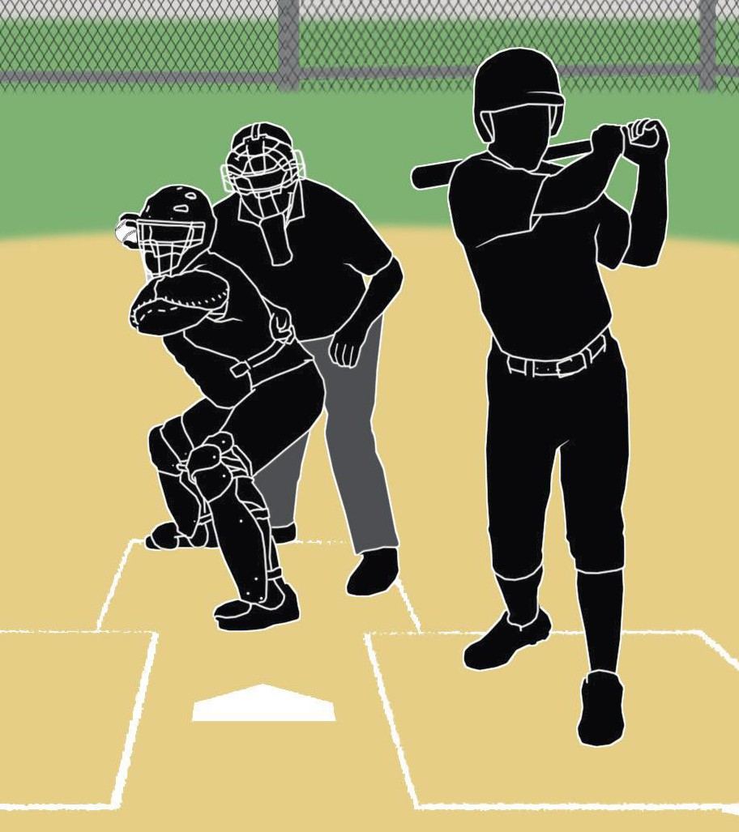
BASERUNNING AWARDS
8-3-6
Rule Change
When the plate umpire hinders, impedes or prevents a catcher’s throw attempting to prevent a stolen base or to retire a runner on a pickoff play, if an out is not made at the end of the catcher’s initial throw, the ball shall be dead and all runners shall return to the bases occupied at the time of the interference.

Slide 23
RULE 8-3-6
Rule Change
ART.6. . . . When a plate umpire hinders, impedes or prevents a catcher's throw attempting to prevent a stolen base or retire a runner on a pickoff play, if an out is not made at the end of the catcher's initial throw, the ball shall be dead and all runners shall return to the bases occupied at the time of the interference.
Rationale: This rule changes provides rules support that was missing from the rules book.

Slide 24
RULE 8-4-2S
Rule Change
s. is physically assisted by a coach. (3-2-2)
Rationale: This rule supports the action taken in Rule 3-2-2 Penalty regarding coaches’ conduct with assisting a base runner.

Slide 25
NFHS UMPIRE MANUAL
CHANGES

Slide 26
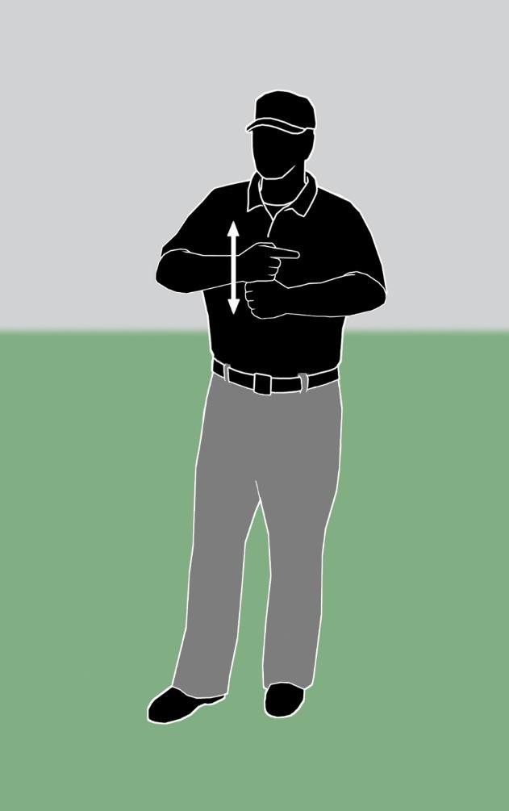
Manual Change
NEW UMPIRE’S SIGNAL
DOUBLE TAG-UP SIGNAL

Slide 27
NEW UMPIRE’S SIGNAL – THE
DOUBLE TAG-UP SIGNAL
Manual Change
The “Double Tag-Up Signal” is one that the umpires give to one another when there are runners on first and second base with less than two outs to indicate that the plate umpire will take any play at third base involving the runner on second base should he tag-up and try to advance.
Rationale: Better communication between umpires.

Slide 28
CHANGING DESIGNATION OF PLATE
UMPIRE AND OTHER BASE UMPIRES
Manual Change
In a 2-man system, the nomenclature of identifying the plate umpire has been changed to Plate Umpire (PU), and U1 now represents the first base umpire.
In a 3-man system, the plate umpire has been changed to Plate Umpire (PU), and U1 now represents the first base umpire and U2 represents the third base umpire.

Slide 29
CHANGING DESIGNATION OF PLATE
UMPIRE AND OTHER BASE UMPIRES
Manual Change
In a 4-man system, the plate umpire would be recognized as PU, U1 now represents the first base umpire, U2 represents the second base umpire and U3 would represent the third base umpire.
Rationale: Clarification and consistency with other codes and teaching/camp curriculum.

Slide 30
NFHS BASEBALL POINTS OF
EMPHASIS

Slide 31
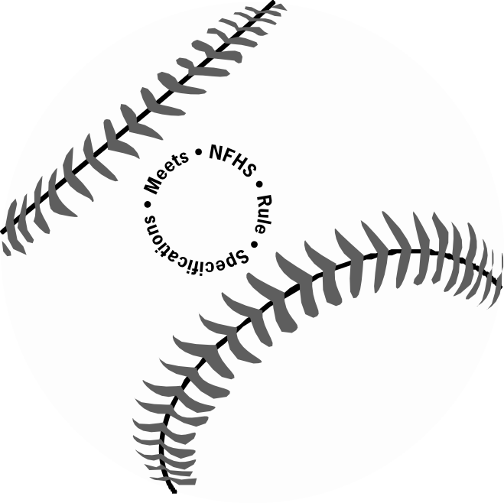
BALL MARKINGS
Points of Emphasis
All baseballs used in interscholastic contests shall meet the specifications outlined in Rule 1-3-1 and shall bear the NFHS Authenticating Mark.

Slide 32
AUTHENTICATED MARK PROGRAM
(AMP)
Points of Emphasis
The NFHS AMP program was designed in 2000 to ensure that the equipment used in interscholastic contests is manufactured consistently and meets certain physical requirements. By using conforming equipment, players, coaches and officials can rest assured that the baseballs used are designed for the age group that we write playing rules for interscholastic competition.

Slide 33
AUTHENTICATED MARK PROGRAM
(CONTINUED)
Points of Emphasis
All such balls are required to display the NFHS Authenticating Mark. Manufacturers make balls to our standards and expect that their products are purchased for game competition. Using non-AMP balls puts players, coaches, fans and umpires at risk of injury and inconsistent playability which hurts high school baseball. Using baseballs that meet the AMP requirements are good for our young people and even better for our game.

Slide 34
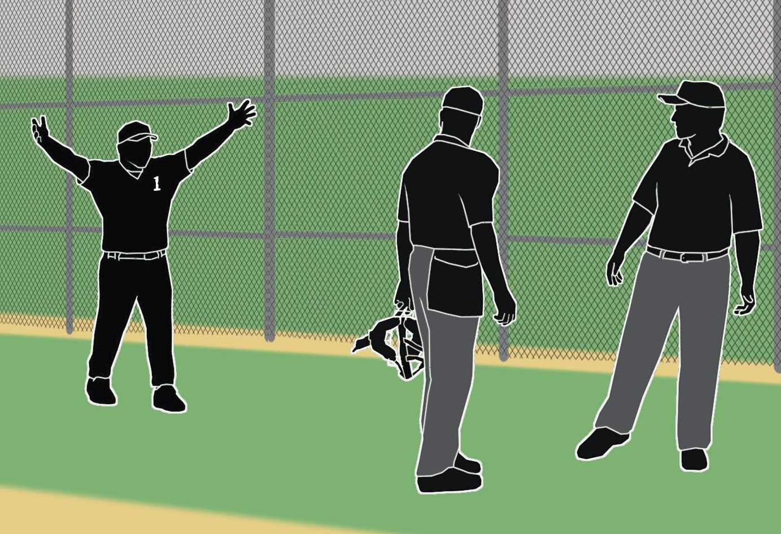
UMPIRE ASKING ASSISTANCE
Points of Emphasis
When requested by a coach, an umpire is not required to seek assistance from a partner.

Slide 35
UMPIRE ASSISTANCE
Points of Emphasis
Often during contests, a coach will request that an umpire seek assistance from his partner for a particular call or play situation. Asking assistance from a partner is not mandatory. It is the discretion of the plate umpire if he feels that his view was obstructed or that his partner had a better angle on the play. If he does feel that his partner’s perspective will provide additional input to his final decision, then he has the flexibility to request his partner’s help.

Slide 36
UMPIRE ASSISTANCE (CONTINUED)
Points of Emphasis
Once the opinion is shared, it is the plate umpire who will make the final determination on the call or play. This entire exchange will be quick and intentional using umpire signals that are relayed to players, coaches and spectators.

Slide 37
Points of Emphasis
LOCATION OF TEAM PERSONNEL
Coaches, player, substitutes, attendants or other bench personnel shall not leave the dugout during live ball for any unauthorized purpose.

Slide 38
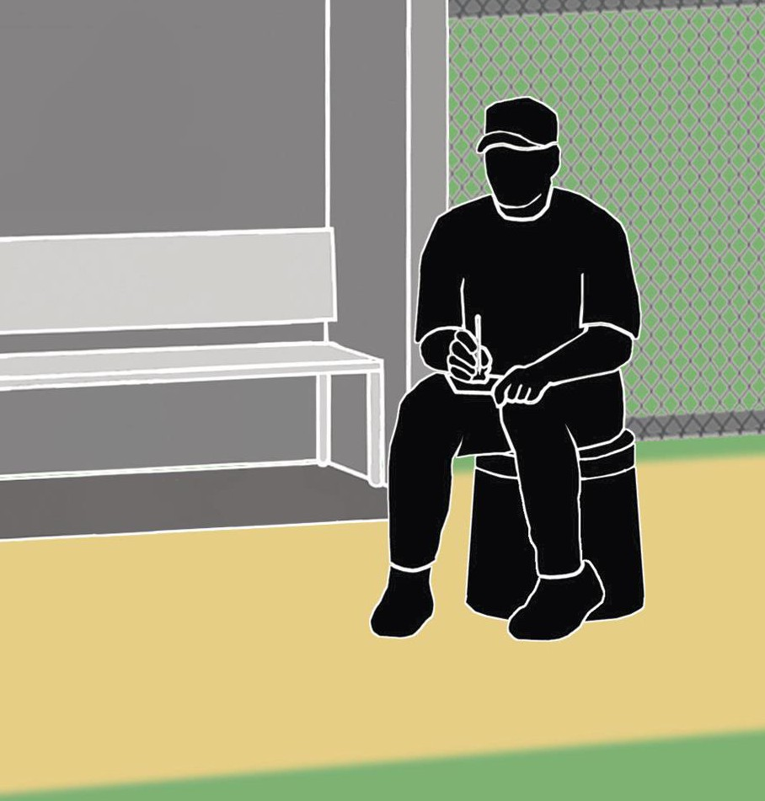
LOCATION OF TEAM PERSONNEL
Points of Emphasis
Additionally, coaches or team personnel may not sit outside the dugout/bench area on buckets or stools.

Slide 39
TEAM PERSONNEL LOCATION
Points of Emphasis
Coaches, players, substitutes, attendants or other bench personnel shall not leave the dugout during live ball for any unauthorized purpose. Coaches or team personnel may not sit outside the dugout/bench on buckets or stools. Players are not allowed to stand or kneel outside their dugout/bench and make “cat-calls” or any other disparaging remarks while the other team is taking infield practice. This is unsportsmanlike behavior and will not be tolerated in interscholastic baseball.

Slide 40
TEAM PERSONNEL LOCATION
(CONTINUED)
Points of Emphasis
Umpires and coaches need to work together for the benefit of the students they officiate and teach. It is these game situations that provide coaches and umpires excellent “teachable moments” to reinforce proper behavior and perspective. The positive values that are learned at the baseball diamond will serve the young people long after their high school careers have ended.

Slide 41
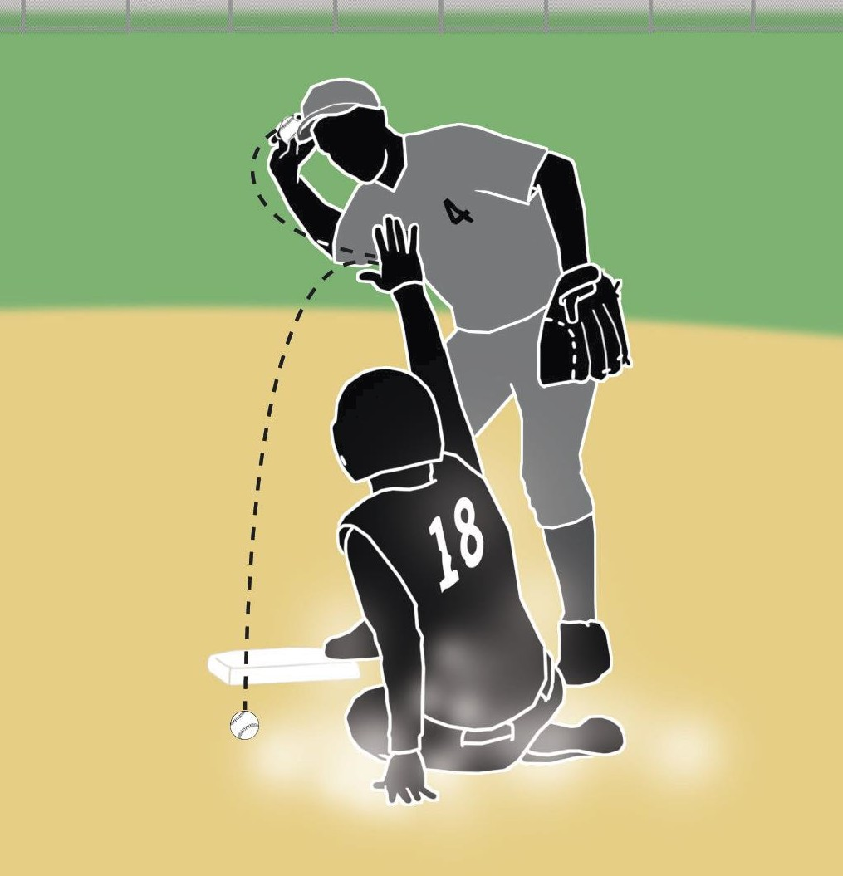
LEGAL SLIDES
Points of Emphasis
Players are never required to slide, but if they choose to do so, the slide must be legal.

Slide 42
LEGAL SLIDES
Points of Emphasis
There has been a misnomer that given a particular play that the base runner has to slide into the base he is trying to acquire. Even the universally accepted “force play slide” is misconstrued as the player having to slide into the base. NFHS rules are specific and very clear that runners are never required to slide. However, if they choose to slide, then the slide must be legal. You can legally slide either feet first or head first. If you choose feet first, then at least one leg and buttock shall stay in contact with the ground.

Slide 43
LEGAL SLIDES (CONTINUED)
Points of Emphasis
A slide is illegal:
if the runner uses a rolling, cross-body or pop-up slide
into the fielder;
if the runner’s raised leg is higher than the fielder’s knee (while he is in a standing position);
if the runner goes beyond the base and then makes contact with the fielder or alters his play;
if the runner slashes or kicks the fielder;

Slide 44
LEGAL SLIDES (CONTINUED)
Points of Emphasis
if the runner intentionally tries to injure the fielder;
and during a force play situation, the runner does not slide on the ground and in a direct line between the two bases;
when a runner slides, he must slide within reach of the base with either hand or a foot.

Slide 45
LEGAL SLIDES (CONTINUED)
Points of Emphasis
The consequence is that the runner is called out and based upon his actions there could possibly be malicious contact and the runner would be ejected from the game. Attention to when it is appropriate to slide and to do it legally will improve the overall process of base-running, reduce unnecessary injuries to the runner and the covering fielder, and make for a more exciting game to watch and enjoy.

Slide 46
THANK YOU AND HAVE A
GREAT SEASON!
www.nfhs.org

